Slide 1
Ray Tracing
Ed Angel
Professor of Computer Science, Electrical and Computer Engineering, and Media Arts
Director, Arts Technology Center
University of New Mexico
Angel: Interactive Computer Graphics 5E © Addison-Wesley 2009

Slide 2
Introduction
OpenGL is based on a pipeline model in which primitives are rendered one at time
  No shadows (except by tricks or multiple renderings)
  No multiple reflections
Global approaches
  Rendering equation
  Ray tracing
  Radiosity
Angel: Interactive Computer Graphics 5E © Addison-Wesley 2009

Slide 3
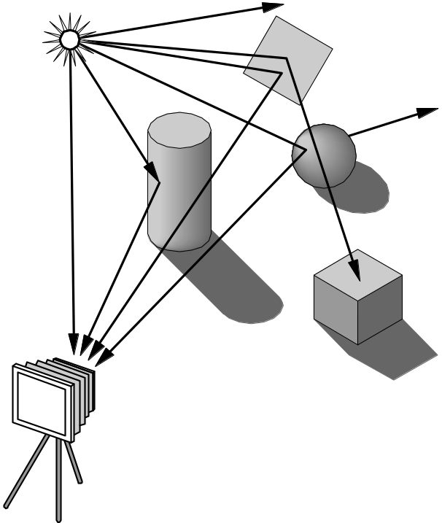
Ray Tracing
Follow rays of light from a point source
Can account for reflection and transmission
Angel: Interactive Computer Graphics 5E © Addison-Wesley 2009

Slide 4
Computation
Should be able to handle all physical interactions
Ray tracing paradigm is not computational
Most rays do not affect what we see
Scattering produces many (infinite) additional rays
Alternative: ray casting
Angel: Interactive Computer Graphics 5E © Addison-Wesley 2009

Slide 5
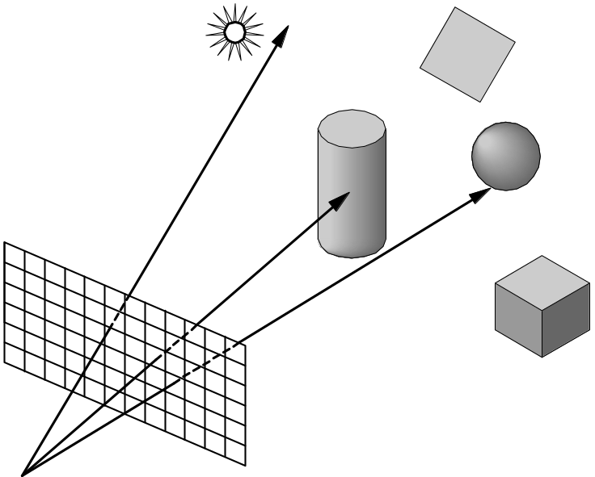
Ray Casting
Only rays that reach the eye matter
Reverse direction and cast rays
Need at least one ray per pixel
Angel: Interactive Computer Graphics 5E © Addison-Wesley 2009

Slide 6
Ray Casting Quadrics
Ray casting has become the standard way to visualize quadrics which are implicit surfaces in CSG systems
Constructive Solid Geometry
  Primitives are solids
  Build objects with set operations
  Union, intersection, set difference
Angel: Interactive Computer Graphics 5E © Addison-Wesley 2009

Slide 7

Ray Casting a Sphere
Ray is parametric
Sphere is quadric
Resulting equation is a scalar quadratic equation which gives entry and exit points of ray (or no solution if ray misses)
Angel: Interactive Computer Graphics 5E © Addison-Wesley 2009

Slide 8
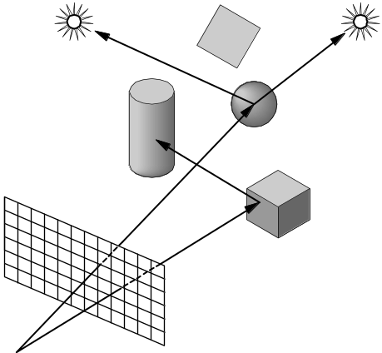
Shadow Rays
Even if a point is visible, it will not be lit unless we can see a light source from that point
Cast shadow or feeler rays
Angel: Interactive Computer Graphics 5E © Addison-Wesley 2009

Slide 9
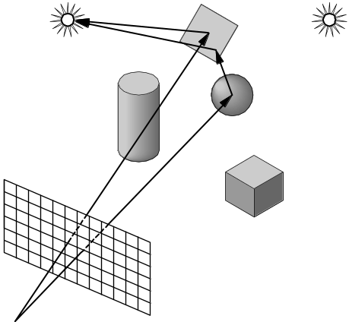
Reflection
Must follow shadow rays off reflecting or transmitting surfaces
Process is recursive
Angel: Interactive Computer Graphics 5E © Addison-Wesley 2009

Slide 10
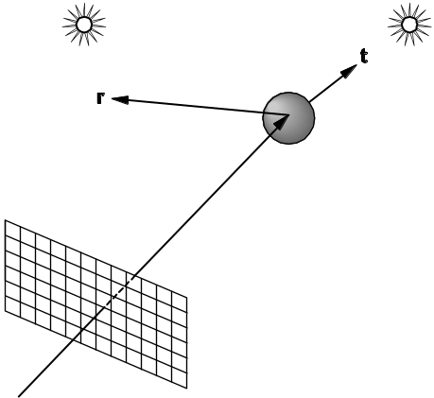
Reflection and Transmission
Angel: Interactive Computer Graphics 5E © Addison-Wesley 2009

Slide 11
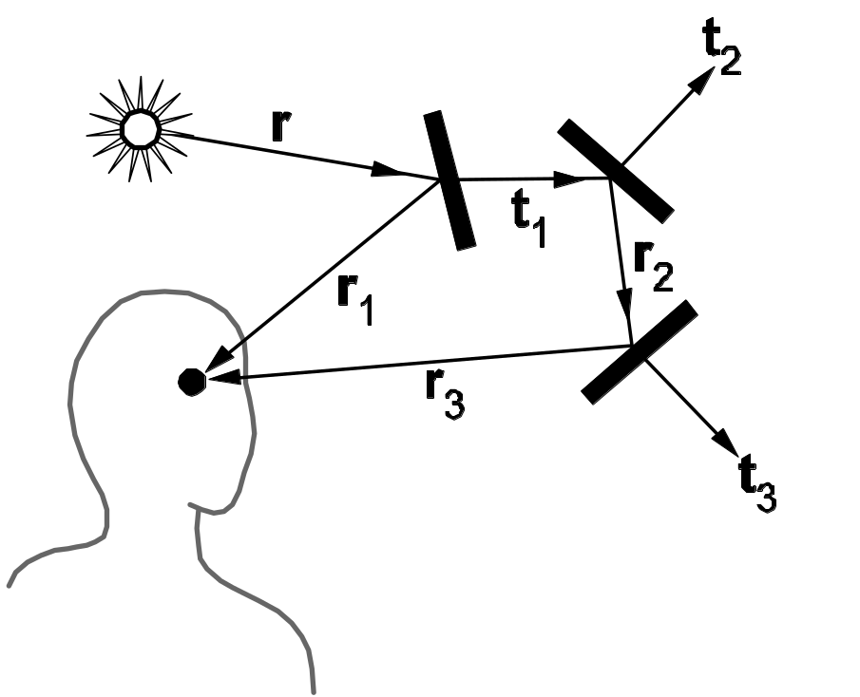
Ray Trees
Angel: Interactive Computer Graphics 5E © Addison-Wesley 2009

Slide 12
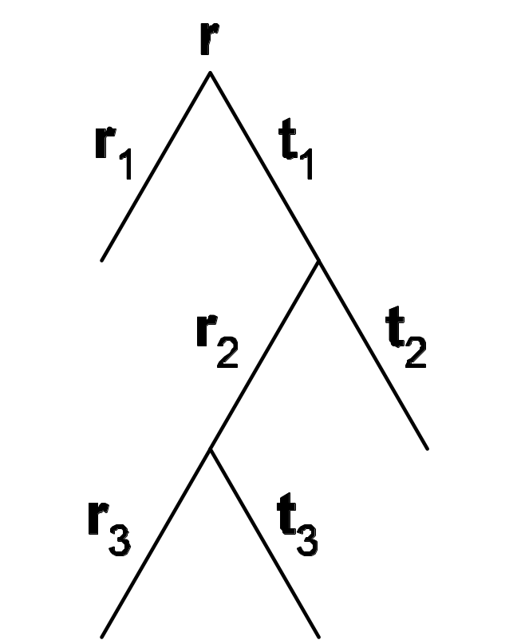
Ray Tree
Angel: Interactive Computer Graphics 5E © Addison-Wesley 2009

Slide 13
Diffuse Surfaces
Theoretically the scattering at each point of intersection generates an infinite number of new rays that should be traced
In practice, we only trace the transmitted and reflected rays but use the Phong model to compute shade at point of intersection
Radiosity works best for perfectly diffuse (Lambertian) surfaces
Angel: Interactive Computer Graphics 5E © Addison-Wesley 2009

Slide 14
Building a Ray Tracer
Best expressed recursively
Can remove recursion later
Image based approach
  For each ray …….
Find intersection with closest surface
  Need whole object database available
  Complexity of calculation limits object types
Compute lighting at surface
Trace reflected and transmitted rays
Angel: Interactive Computer Graphics 5E © Addison-Wesley 2009

Slide 15
When to stop
Some light will be absorbed at each intersection
  Track amount left
Ignore rays that go off to infinity
  Put large sphere around problem
Count steps
Angel: Interactive Computer Graphics 5E © Addison-Wesley 2009

Slide 16
Recursive Ray Tracer
color c = trace(point p, vector d, int step)
{
color local, reflected, transmitted;
point q;
normal n;
if(step > max) return(background_color);
Angel: Interactive Computer Graphics 5E © Addison-Wesley 2009

Slide 17
Recursive Ray Tracer
q = intersect(p, d, status);
if(status==light_source) return(light_source_color);
if(status==no_intersection) return(background_color);
n = normal(q);
r = reflect(q, n);
t = transmit(q,n);
Angel: Interactive Computer Graphics 5E © Addison-Wesley 2009

Slide 18
Recursive Ray Tracer
local = phong(q, n, r);
reflected = trace(q, r, step+1);
transmitted = trace(q,t, step+1);
return(local+reflected+
transmitted);
Angel: Interactive Computer Graphics 5E © Addison-Wesley 2009

Slide 19
Computing Intersections
Implicit Objects
  Quadrics
Planes
Polyhedra
Parametric Surfaces
Angel: Interactive Computer Graphics 5E © Addison-Wesley 2009

Slide 20
Implicit Surfaces
Ray from p₀ in direction d
p(t) = p₀ +t d
General implicit surface
f(p) = 0
Solve scalar equation
f(p(t)) = 0
General case requires numerical methods
Angel: Interactive Computer Graphics 5E © Addison-Wesley 2009

Slide 21
Quadrics
General quadric can be written as
  p^{T}Ap + b^{T}p +c = 0
Substitute equation of ray
p(t) = p₀ +t d
to get quadratic equation
Angel: Interactive Computer Graphics 5E © Addison-Wesley 2009

Slide 22
Sphere
(p – p_{c}) • (p – p_{c}) – r² = 0
p(t) = p₀ +t d
p₀ • p₀ t²+ 2 p₀ • (d – p₀) t + (d – p₀) • (d – p₀)
– r² = 0
Angel: Interactive Computer Graphics 5E © Addison-Wesley 2009

Slide 23
Planes
p • n + c = 0
p(t) = p₀ +t d
t = -(p₀ • n + c)/ d • n
Angel: Interactive Computer Graphics 5E © Addison-Wesley 2009

Slide 24
Polyhedra
Generally we want to intersect with closed objects such as polygons and polyhedra rather than planes
Hence we have to worry about inside/outside testing
For convex objects such as polyhedra there are some fast tests
Angel: Interactive Computer Graphics 5E © Addison-Wesley 2009

Slide 25
Ray Tracing Polyhedra
If ray enters an object, it must enter a front facing polygon and leave a back facing polygon
Polyhedron is formed by intersection of planes
Ray enters at furthest intersection with front facing planes
Ray leaves at closest intersection with back facing planes
If entry is further away than exit, ray must miss the polyhedron
Angel: Interactive Computer Graphics 5E © Addison-Wesley 2009

Slide 26
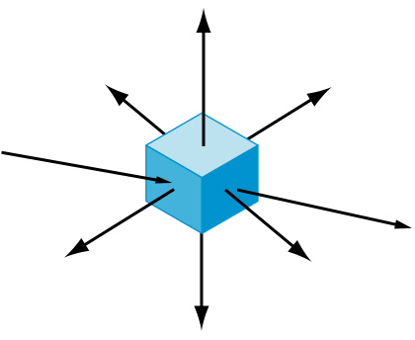
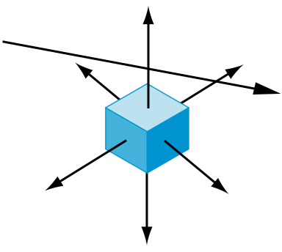
Ray Tracing Polyhedra
Angel: Interactive Computer Graphics 5E © Addison-Wesley 2009

Slide 27
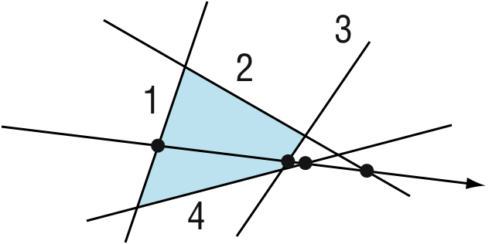
Ray Tracing a Polygon
Angel: Interactive Computer Graphics 5E © Addison-Wesley 2009

Slide 28
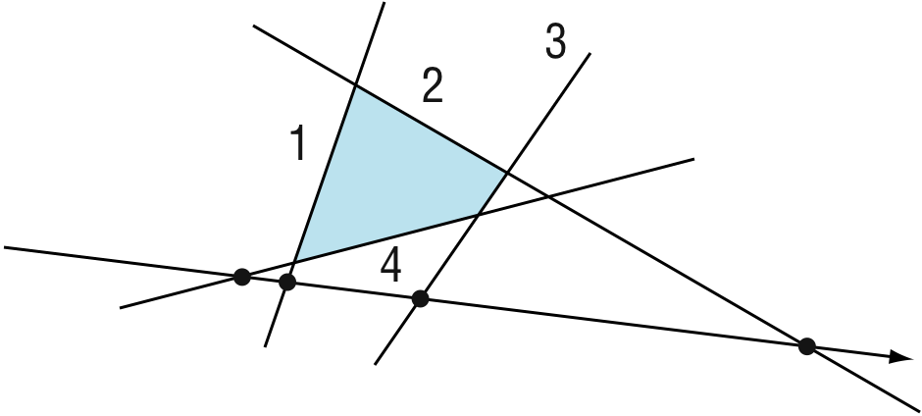
Ray Tracing a Polygon
Angel: Interactive Computer Graphics 5E © Addison-Wesley 2009

